Slide 1


SPHOORTHY
ENGINEERING COLLEGE
TEACHING LEARNING CENTER

Slide 2
Asynchronous Sessions

Slide 3
S.NO. | FACULTY NAME | DEPT. | TOPIC | SESSION | DATE | LINK FOR ONLINE
1 | Dr. P. GAYATHRI PAVANI | Phy | TRAINING AN EDUCATOR | Online Webinar | 20 May 2020 | Online session
2 | Mr. Lokanath | ECE | Conducting Online meeting with database proof | Recorded Video | 21 May 2020 | https://youtu.be/ytUUVwJWuJg
3 | Mr. Seshacharyulu | MECH | NEAT | Recorded Video | 22 May 2020 | https://drive.google.com/file/d/1UjhkXJVtXdbURr0wRSmOSIBDXzz3AtIq/view?usp=sharing
4 | Mrs. Shailaja | ECE | Screen Casto Matic | Recorded Video | 23 May 2020 | https://youtu.be/-N7mWV5Z_24
5 | Mr. G. Swaroop | MECH | Over view of Machine Learning Python | Online Webinar | 25 May 2020 | Online session
6 | Mr. PoornaChander | ECE | Hw to use Google sites for teachers | Recorded Video | 26 May 2020 | https://youtu.be/lQs_kRe6FiI
7 | Mr. Poorna Chander | ECE | Response validitation using general formula in Google form | Recorded Video | 26 May 2020 | https://youtu.be/7MWPGrXO0Fc
8 | Mr. PoornaChander | ECE | How to use Nearpod | Recorded Video | 26 May 2020 | https://youtu.be/UTa3uEnTeaw
9 | Mr. Arvind | CSE | PYTHON | Recorded Video | 30 May 2020 | https://www.youtube.com/watch?v=EXXwrkGRSoY&list=PLnsQVdy457NoGmQqGrfFwWw0edwnU2LAJ&index=2&t=0s
10 | Mrs. Meghana | CSE | E-Learning Tools | On line Webinar | 01 June 2020 | Online session

Slide 4
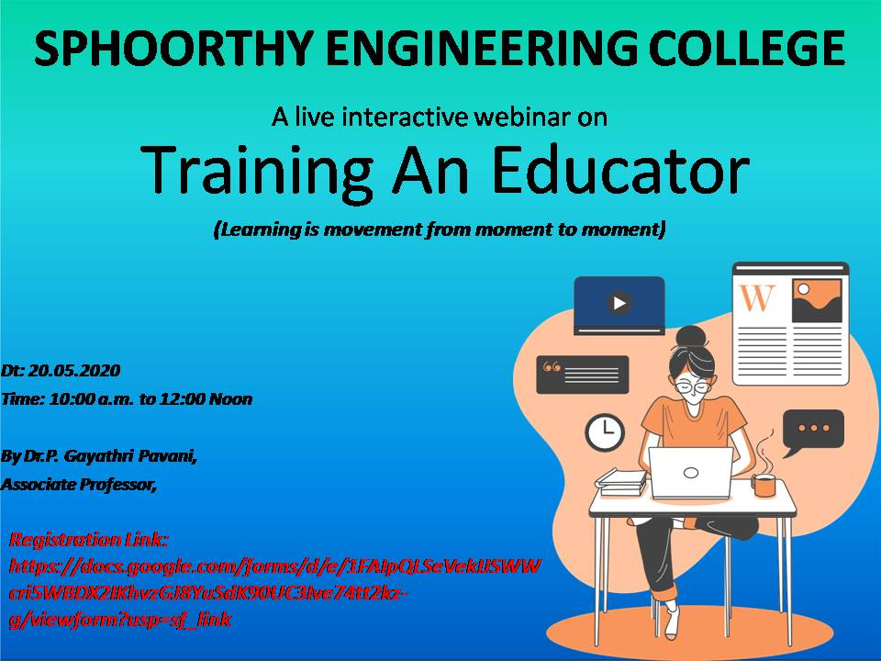
Talk focused on:
Teaching, Learning and Evaluation
Professional Development, Co-Curricular and Extension Activities
Research and Development
Development of E-Learning Delivery Process/Material
Platform: Google MEET
Number of Participants: 60

Slide 5
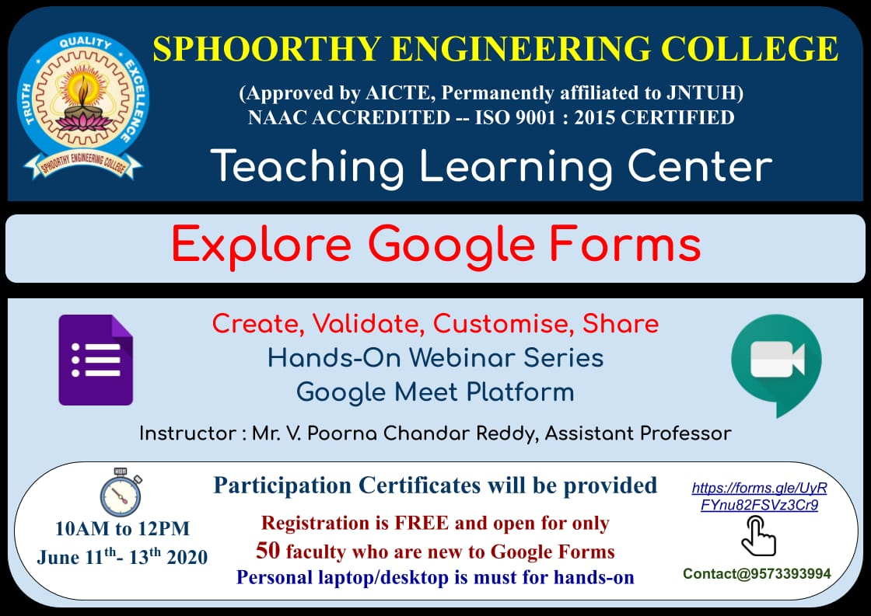
Session Recordings:
Day-01:
https://youtu.be/aLs68-yaD4s
Day-02:
https://youtu.be/wtk7S6dI9Zg
Day-03:
https://youtu.be/XBGBDmOVohk

Slide 6
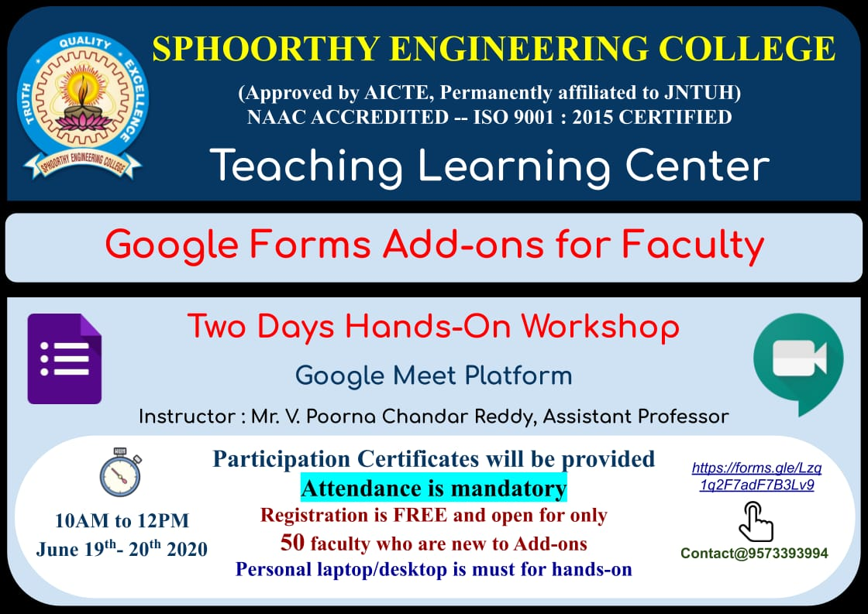
Recording of the session:
https://www.youtube.com/playlist?list=PLpDOz6lW3UrkRUU69TwKxPvwCvw4zszN3

Slide 7

No. of Participants: 65
Day 1:
https://youtu.be/1dQAZUsT5W4
Day 2:
https://youtu.be/EHO0JTJXLsA

Slide 8

Recording of the session:
https://www.youtube.com/playlist?list=PLpDOz6lW3Url2VX8llACENv-nAOHPC8b3

Slide 9

No. of Participants: 45
ICT tools:
PADLET
PLICKERS
CLASSCRAFT
MOODLE

Slide 10

No. of Participants: 113
No. of papers presented: 32
Key Note sessions: 07
Day-01 link:
https://drive.google.com/file/d/1NPp_5poLEfoVz0tn8r9YabQiABZRb6H-/view?usp=sharing
Day -02 link:
https://drive.google.com/file/d/1tLrw0bu87WOkbVhE8DsY87c6mCnMIZKt/view?usp=sharing
Day – 03 link:
https://drive.google.com/file/d/1iIoytog-4xXByT8aCirAin8Wdlc0Ozti/view?usp=sharing

Slide 11
Schedule Of ICETP2020: https://drive.google.com/file/d/17GhAcPtFcipyL_3fYpSU6SyuNCXvhQKa/view?usp=sharing
Guidelines for the conference:
https://drive.google.com/file/d/1vl6W_piGU_yCHhhM9VE541BEANKbDps0/view?usp=sharing
Paper id:
https://drive.google.com/file/d/1s0g8Th3onlLlKGc7rAjMFyeReOYyfMJ6/view?usp=sharing

Slide 12
Faculty Interaction: Classroom Management In an Online Class
No. of Speakers: 03
No. of Participants: 103
https://drive.google.com/file/d/1_WumgCgqOKXJeA2pgifSPB9j88NrFo3D/view?usp=sharing
Virtual Training on Essential Tools for Virtual Classes:
Topic | Name of The Resource Person | Date | Link | No. Of Participants
Design Power point Presentation | Ms. Vigneswari | 19/08/2020 | https://drive.google.com/file/d/1bjZ18bS-qGg80oQ_TfXw91uSX7XLU96Q/view?usp=sharing | 69
Animations in power point presentations | Ms. Meghana | 20/08/2020 | https://drive.google.com/file/d/17fnI1Gj4T7RdpmzMLqZMv_pq25562BIX/view?usp=sharing | 67
Interactive tools for virtual Classes | Ms. Bindu Bhavani | 21/08/2020 | https://drive.google.com/file/d/1we3xZleN5uNIGYo6cNIMAXl2hjMXnFd3/view?usp=sharing | 55
Windows 10 For Educators | Mr. Manjunath | 24/08/2020 | https://drive.google.com/file/d/1Zol4xjOE8IwDihqsIBAFwRGRW41P92Ut/view?usp=sharing | 48
Virtual Board for Mathematical equations & Derivations | Dr. P. Gayathri Pavani | 25/08/2020 | https://drive.google.com/file/d/1DG0OBuGTLduqgkBdfM4ojDK-dCknGmam/view?usp=sharing | 69
Assessment & Feedback | Mr. PoornaChander | 26/08/2020 | https://drive.google.com/file/d/1yDv3Z2t23AH2MYlp4Btv7LledLq1eCO8/view?usp=sharing | 60
Features of Google Meet for Virtual Class | Dr. P. Gayathri Pavani | 27/08/2020 | https://drive.google.com/file/d/14gTr340YhEaWu3m-v3JxxIGsZ1XLz9ue/view?usp=sharing | 65
Code Tantra | Mr. Ramesh | 28/08/2020 | https://drive.google.com/file/d/1KXnNIg-G8SOUUnReyYxOHPunp_Ile2p-/view?usp=sharing | 82
Reference Globe | Mr. Kiran Kumar | 29/08/2020 | https://drive.google.com/file/d/1c02Xwj5Gk_NpHchDBlVujKNV_cY7nArY/view?usp=sharing | 75

Slide 13
Faculty Demonstrations
Faculty Name | Department | Topic Name | Date | Link
Mr. Rama Krishna | CSE | Jam Board | 12/9/2020 | https://drive.google.com/file/d/1zvY6oOGnOIwSPdNY8ZEP8wJ5I-82mkaa/view?usp=sharing
Mr. Kiran Kumar | CSE | Animations in PPT
Mrs. Swetha | Civil | Live Board
Ms. Aarthi | English | Loom and Google Doc
Mr. T. Santosh | ECE | StormBoard | 9/9/2020 | https://drive.google.com/file/d/1uPYnRlkZ7rWvPoMLqVS3aZnc4pXiSFgU/view?usp=sharing
Mrs. Sridevi | ECE | Padlets
Mr. Mukesh | ECE | MindMap
Mr. Yaseen Pasha | CSE | Canvas - LMS | 8/9/2020 | https://drive.google.com/file/d/1Axu57a8CGqATWu3YLSLvSyveEPURy5N9/view?usp=sharing
Mrs. Deepthi | CSE | Quiziz
Ms. Priya | ECE | Sutori- Presentation tool
Mrs. Rajani | ECE | PPt lecture presentation using nobile inbuilt screen recorde | 7/9/2020 | https://drive.google.com/file/d/1lqUkQrvzb6A-7RZWmnhDktGmlcU8uCB6/view?usp=sharing
Mr. Kiran Kumar | ECE | Online Teaching Techniqus
Mr. Venkanna | CHEMISTRY | Screen Recording
Mrs. Sriveni | CSE | ZOOMIT & HYPACIA using google slide

Slide 14
Mrs. Haritha | ECE | Loom | 4/9/2020 | https://drive.google.com/file/d/1QsogxZZiQVkk9UmOrr_n2jvSh6c3R28Y/view?usp=sharing
Mr. AliMubeen | ECE | Hot Potatoes
Dr. Syed Azad | CSE
Dr. Srikanth | CSE | Epic Pen | 3/9/2020 | https://drive.google.com/file/d/1f98Ym03JawLLwCr39YAe3JVlwji38Gqi/view?usp=sharing
Mr. Arvind | CSE | Microsoft White Board
Mrs. Shailaja | ECE | Thnglink
Mrs. L. Aparna | CIVIL | Kahoot
Akhila | CSE | Quiziz | 2/9/2020 | https://drive.google.com/file/d/1f98Ym03JawLLwCr39YAe3JVlwji38Gqi/view?usp=sharing
Chandra Sekhar | ECE | Concept Board Online Teaching
Mr. Ch. Nikhesh | MECH | Crooswordpuzzle usin Google Sheets
Mr. Tirupathi | EEE | Recording lectures using Youtube

Slide 15

Number Of Participants: 64
Focus of Talk: Equipments necessary for streaming and recording videos.
Recording Link:
https://drive.google.com/file/d/1tmfd5obhcz5SwGC2E0iYk17m43qPjNw0/view?usp=sharing

